Slide 1
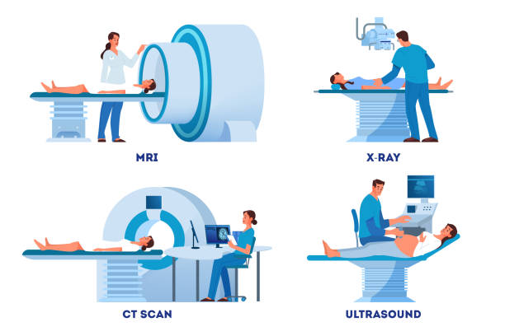
Introduction
Dr. Ahmed Elsawaf. MD
Lecturer Of Radiology

Slide 2
Week 1 | Introduction | Week 8 | Abdomen
Week 2 | Chest | Week 9 | Pelvis
Week 3 | Chest | Week 10 | Spine
Week 4 | Brain | Week 11 | Petrous
Week 5 | Brain | Week 12 | Neck
Week 6 | Paranasal, orbits | Week 13 | Revision
Week 7 | Mid term | Week 14 | Revision

Slide 3
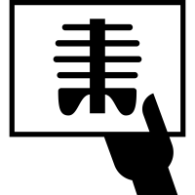
X-RAY

Slide 4
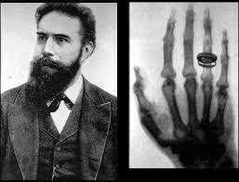
roentgen

Slide 5
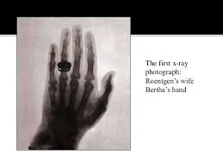
First x-ray photograph

Slide 6
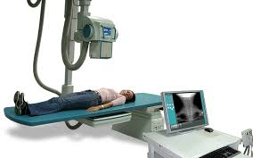
X-Ray machine

Slide 7
Advantages
Disadvantages
Primary imaging tool.
Cheap.
Available.
Radiation exposure.
Contraindications e.g. pregnancy

Slide 8
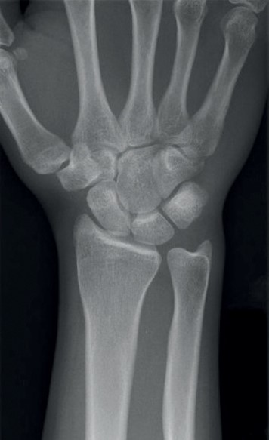
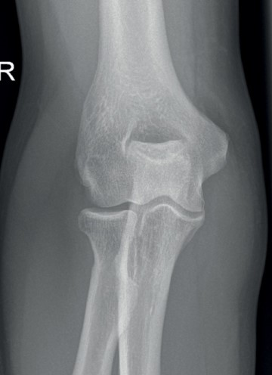
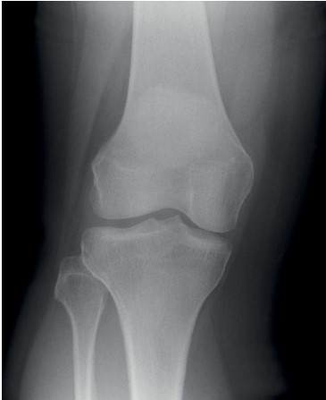
X-Ray antero-posterior view

Slide 9
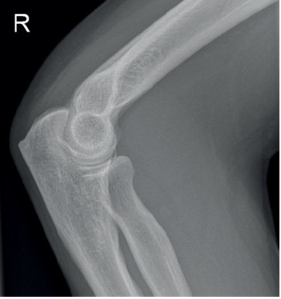
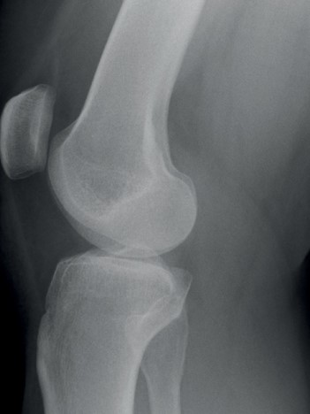
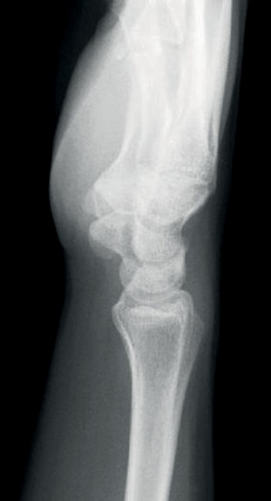
X-Ray lateral view

Slide 10
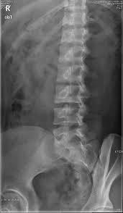
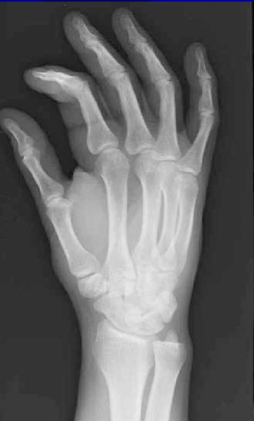
X-Ray oblique view

Slide 11
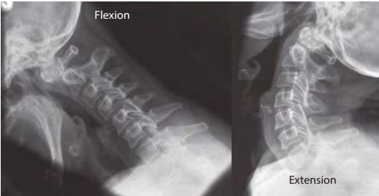
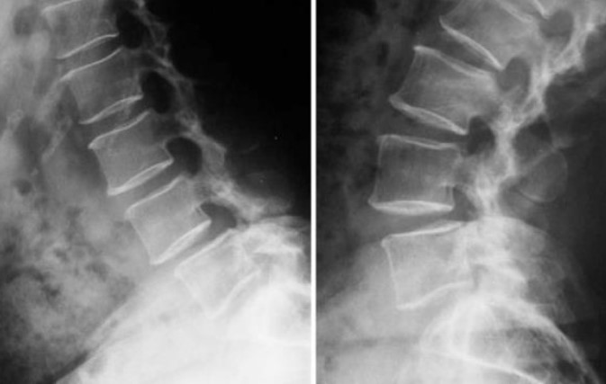
X-Ray dynamic study

Slide 12
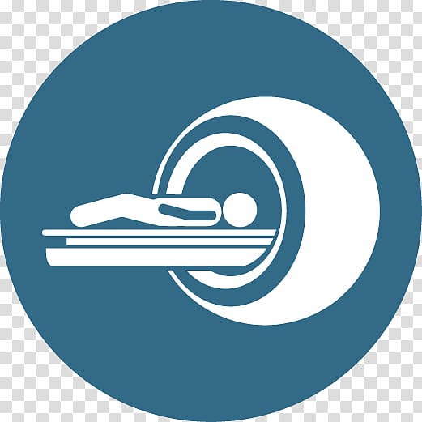
COMPUTED TOMOGRAPHY
(CT)

Slide 13
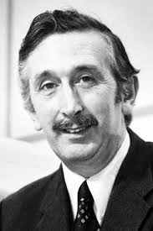
Hounsfield

Slide 14
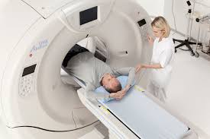
Ct machine

Slide 15
Advantages
Disadvantages
Fast.
Accurate specially in areas of complex anatomy e.g. spine and pelvis.
Sensitive
Radiation exposure.
Contraindications e.g. pregnancy.

Slide 16
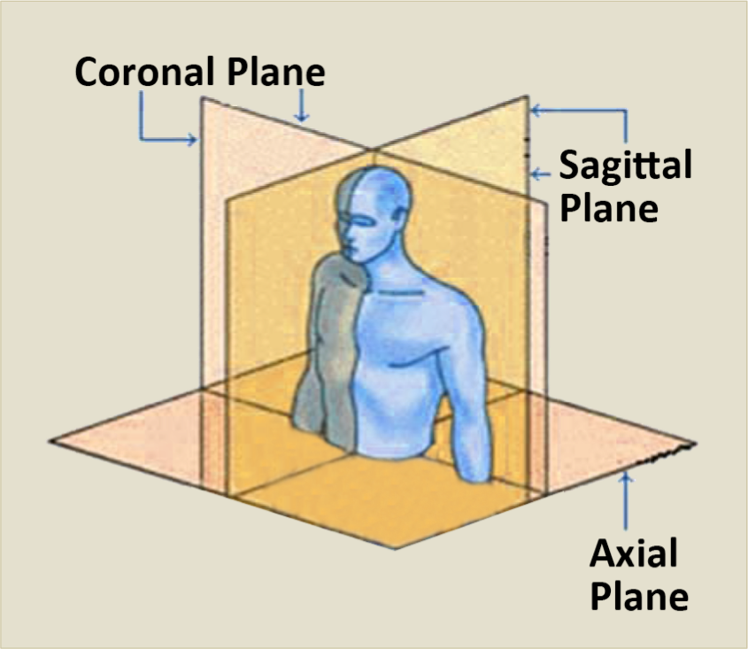

Slide 17
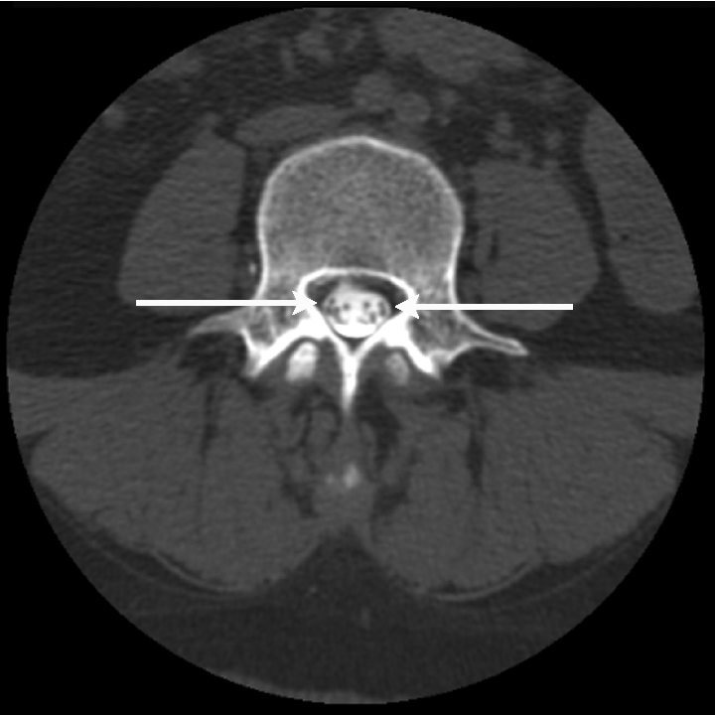
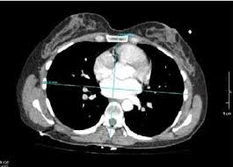
Ct axial cuts

Slide 18
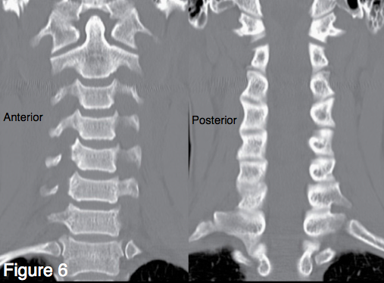
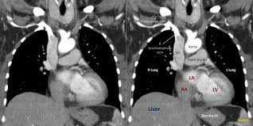
Ct coronal cuts

Slide 19
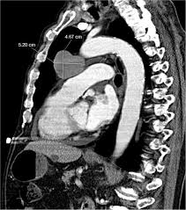
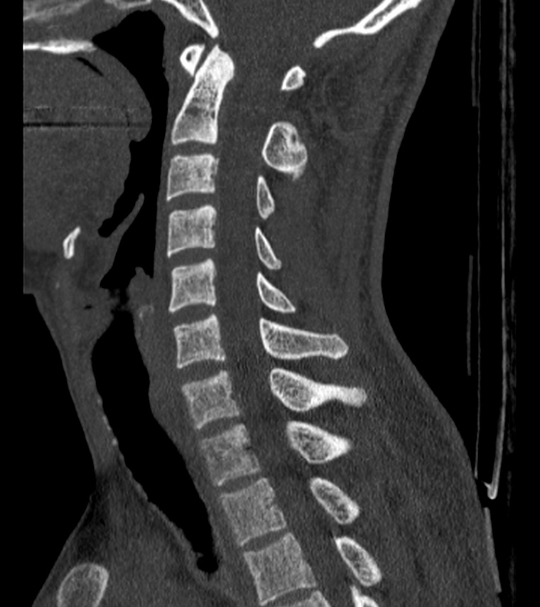
Ct sagittal cuts

Slide 20
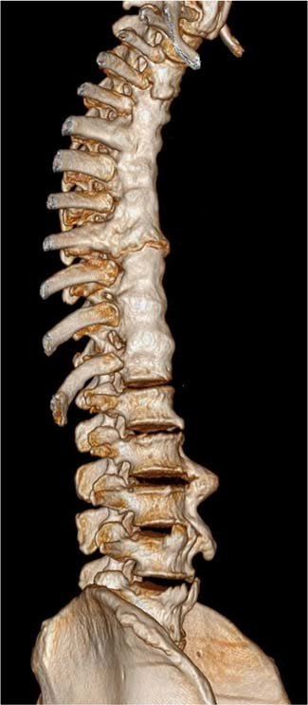
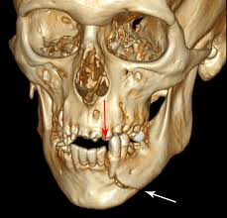
Ct 3D

Slide 21
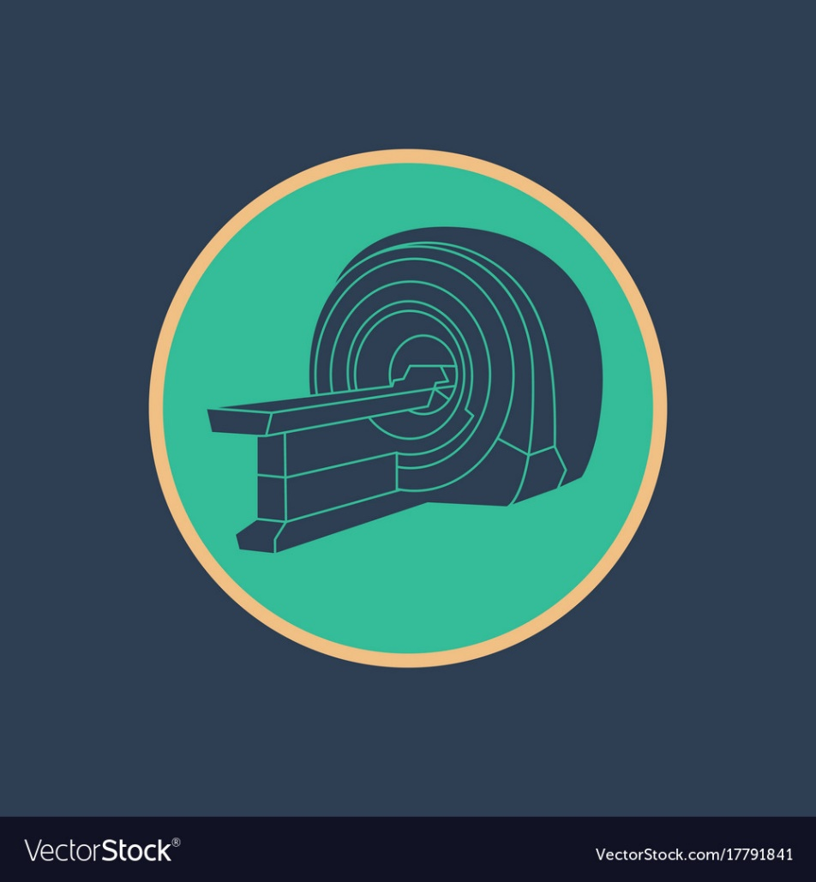
MAGNETIC RESONANCE IMAGING
(MRI)

Slide 22
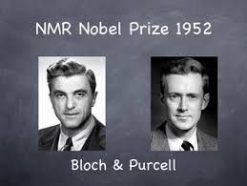
Bloch and purcell

Slide 23
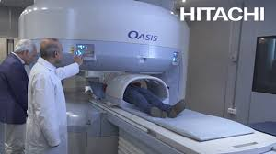
Mri machine

Slide 24
Advantages
Disadvantages
Excellent resolution.
Soft tissue.
Expensive.
Long time
Claustrophobia in closed MRI.
Contraindications e.g. cardiac valve prosthesis, nonferromagnetic metallic internal fixators, intra-cranial aneurysm clips.

Slide 25
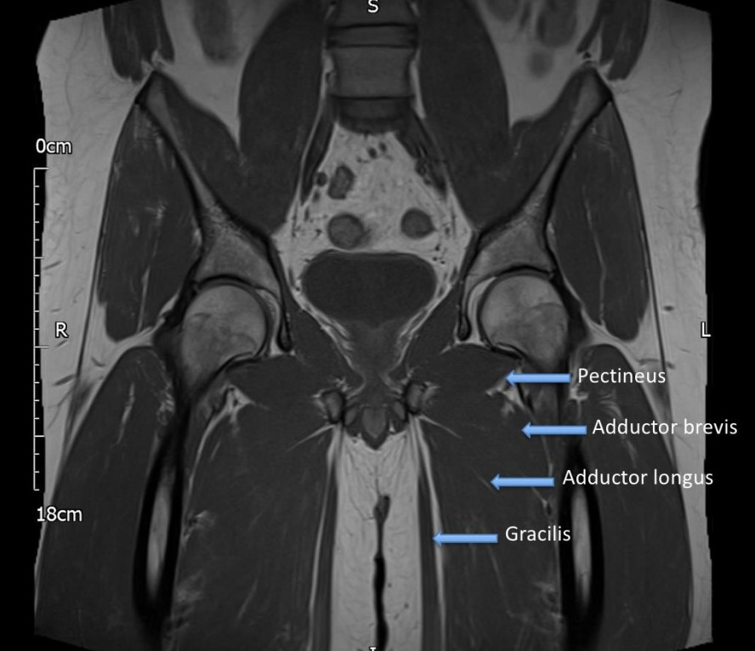

Slide 26
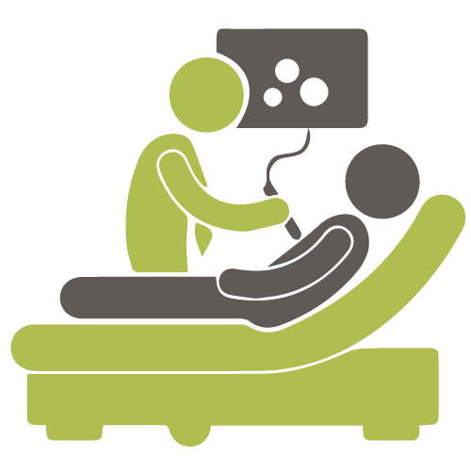
ULTRASOUND
(US)

Slide 27
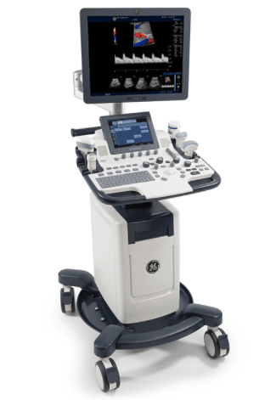
Ultrasound machine

Slide 28
Advantages
Disadvantages
No radiation exposure
Simple.
Fast.
Cost-effective.
Patient friendly specially for claustrophobic patients not fit for MRI
Needs high operator experience.

Slide 29
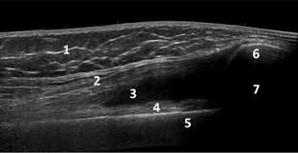
Fluid
(joint effusion)

Slide 30
PLANES OF THE BODY:-
• Sagittal : A plane extending along the long axis of the body dividing it into right and left sides.
• Coronal : A plane extending through the body dividing it into anterior and posterior parts.
• Axial: A plane extending across or through the axis of the body, extending from side to side, dividing the body into superior and inferior portions.

Slide 31
Ct axial cuts

Slide 32
Ct coronal cuts

Slide 33
Ct sagittal cuts

Slide 34
Hounsfield unit
Based on a series of complex mathematical processes, the computer reconstructs the image from a series of digital numbers. The numbers generated are registered on the Hounsfield scale, by which bone is 1,000, water is 0, and air is -1,000

Slide 35
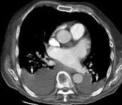
Identify? Air, fat, fluid and bone

Slide 36
CT windowing
CT windowing is an image processing technique that adjusts the brightness and contrast of a CT scan by manipulating its greyscale values to highlight specific tissues or structures, such as bone or soft tissue

Slide 37
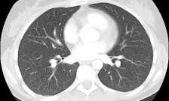
Lung window

Slide 38
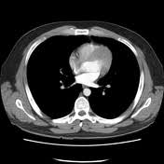
Mediastinum window

Slide 39
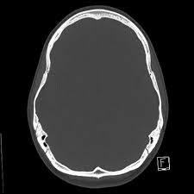
Bone window

Slide 40
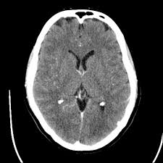
Brain window

Slide 41
Thank you

